Slide 1

Welcome to Year 5
SEPTEMBER 2026

Slide 2
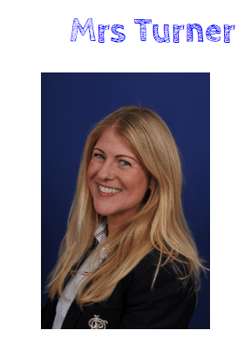
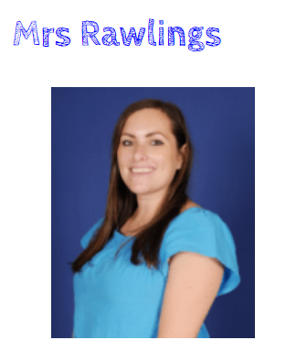
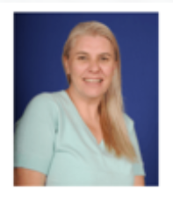
Teachers
Mrs. Rawlings
Wednesday, Thursday and Friday
Mrs. Turner
Monday and Tuesday
Mrs. Whalley
Daily in the mornings
Teaching assistant

Slide 3
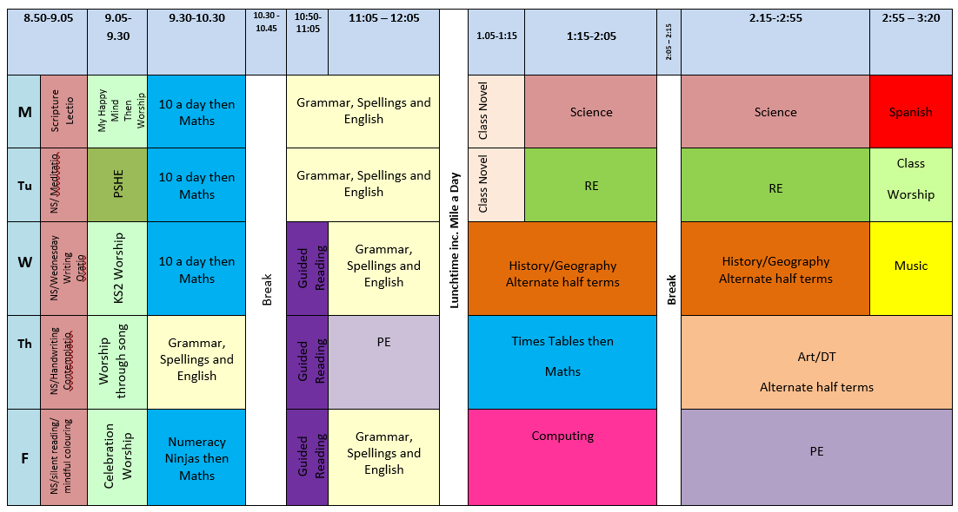
Timetable

Slide 4

Snacks and Water
Fruit or something healthy can be brought in as a snack for break time.
            No crisps
            No chocolate
            No pepperoni etc.,
Water only please - juice is fine for lunchtime.

Slide 5

Reading
Your child will be given a reading book. As we encourage greater independence in Year 5, children will change reading books themselves in school when needed and record it on their school reading sheet.
Children also have access to class books which they are free to read for pleasure and change themselves anytime.
We have a volunteer, Mrs. Duckworth who comes in on Wednesday mornings to read and practise handwriting with children.

Slide 6
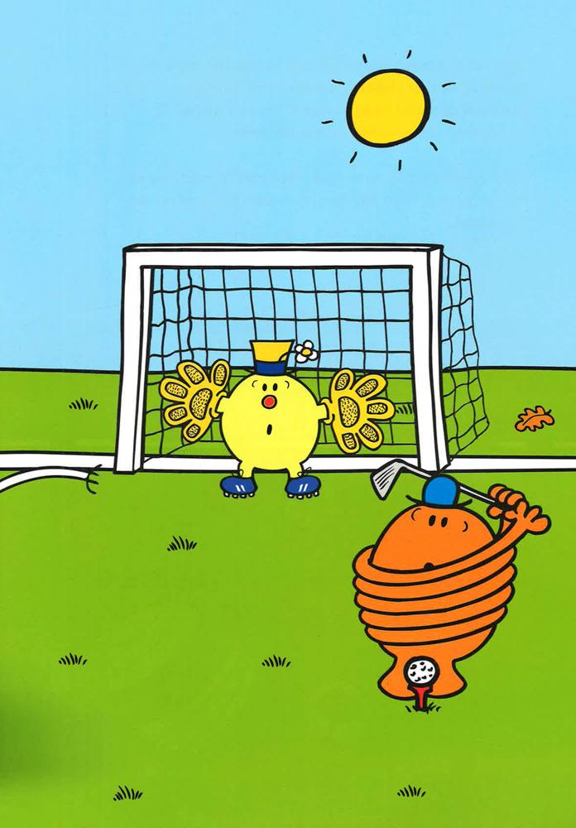
PE
PE will be on Thursdays and Fridays.
Leggings/jogging bottoms/shorts must be plain black or navy.
On PE days, children should wear their kit to school.
Earrings and any other jewellery must not be worn on PE days.

Slide 7

Homework
Homework is given out on a Friday and is to be handed in the following Friday (or earlier!)
However, children should be reading daily and practicing spellings and times tables regularly.

Slide 8

Rewards and Sanctions
Raffle Tickets will be awarded for outstanding effort, work or behaviour. One ticket will be drawn at random on Fridays and winners will receive a reward from the prize box.
Dojo awards. Once a child reaches 100 Dojo points, they will receive extra break with a friend.
1,2,3 warning system. Children will receive warnings for any unacceptable behaviours in class and around school. If a child is given 3 warnings, they will have a consequence such as missing a session on the MUGA/spending time in reflection.

Slide 9

Class Webpage
This will include the Curriculum Overview for the half term.
Spellings each term.
Sticky Learning for the half term.
Class timetable.
This Meet the Teacher ppt

Slide 10

Class Notices
Class Dojo has been set up. Any whole class related information will be put onto the class Dojo page.
If you need to contact myself or Mrs. Rawlings, Dojo can be use to send messages, however, these should be limited to school times rather than evenings and weekends. We will reply when possible, but any urgent messages should be sent via the school office.
WhatsApp groups – please encourage children NOT to set these up among themselves.

Slide 11

How you can help…
Learn their times tables with them.
Practise Sticky Learning with them.
Read with them and to them.
Encourage independence.

Slide 12
General Reminders
Uniform – please label everything!
No large backpacks.
Bobbles must be plain and small.
Lateness – please be on time between 8:45am and 8:55am.
Policies available on the school website.
We are available on Dojo if you need anything.

